Slide 1
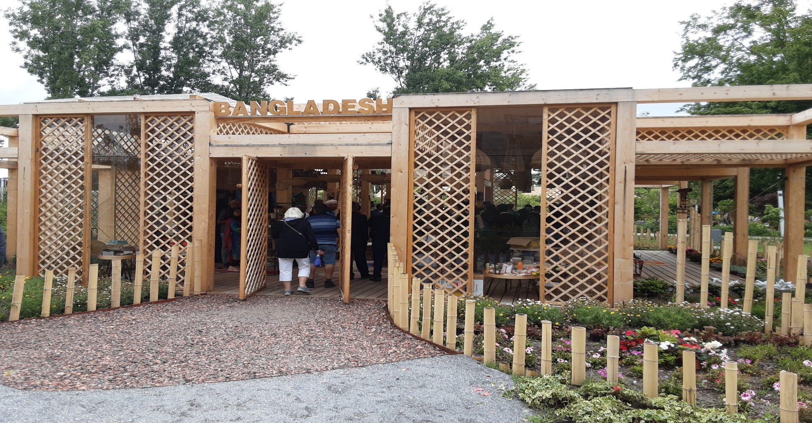

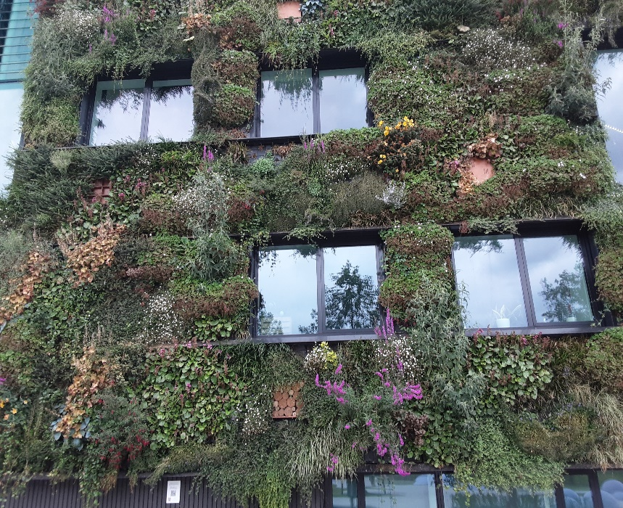
Group IV presentation on vegetation biophysical variables

Slide 2
Group member | Supervisor
A.F.M. RUHUL QUDDUS (BARI) | Dr. ROSHANAK DARVISHZADEH associate professor Faculty of Geo-Information Science and Earth Observation (ITC), University of Twente
DR. SELIM AHMED (BARI)
MST SALINA AKTER (BARI)
MD MOSIUR BHUYIN APU (BARI)
MUSTAFA KAMAL SHAHADAT (BARI)
MUSTAFA KAMAL (CIMMYT)

Slide 3
Understanding the relationship of remote sensing indices with LAI of wheat and maize crops in southern saline region of Bangladesh

Slide 4
Objectives
To find out the suitable bands and vegetation indices from Rapideye image and assess their relationship with measured Leaf Area Index (LAI) in saline region
To develop model for predicting yield using the best indices/bands considering biophysical variable (LAI)

Slide 5
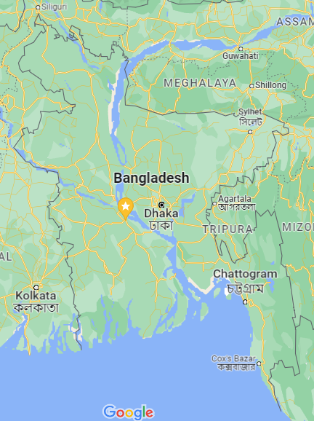
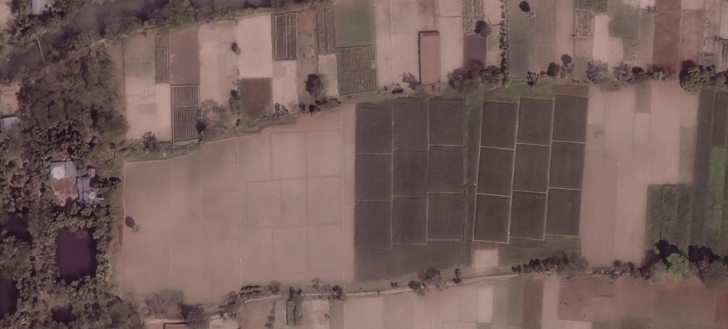
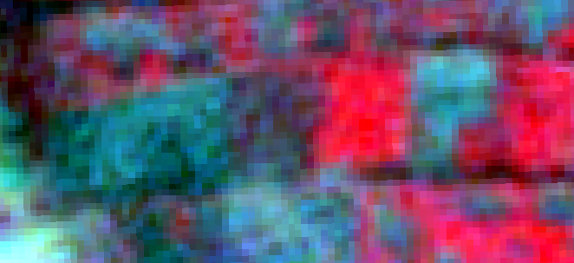
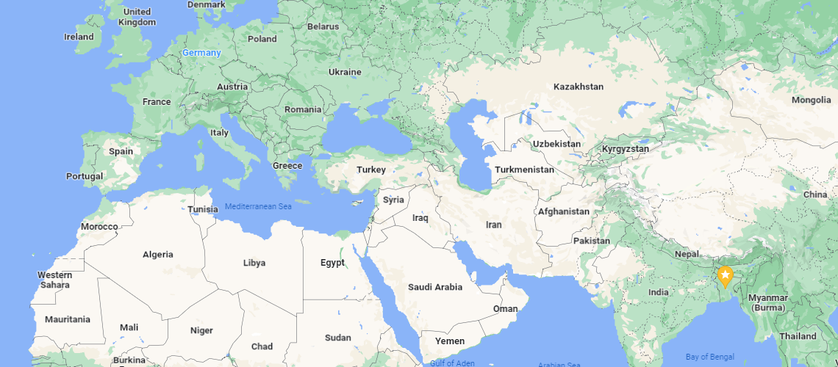
Barishal
Bangladesh

Slide 6
Wheat
Vegetation Index | R² (Standard bands) | Band | R² (using other bands) | Band
NDVI | 0.37 | NIR, Red | 0.43 | NIR, Red edge
DVI | 0.37 | NIR, Red | 0.41 | NIR, Red edge
RVI | 0.41 | NIR, Red | 0.45 | NIR, Red edge

Slide 7
Maize
Vegetation Index | R² (Standard bands) | Band | R² (using other bands) | Band
NDVI | 0.53 | NIR, Red | 0.54 | NIR, Red edge
DVI | 0.40 | NIR, Red | 0.47 | Red, Blue
RVI | 0.52 | NIR, Red | 0.55 | NIR, Green

Slide 8
Wheat and Maize
Vegetation Index | R² (Standard bands) | Band | R² (using other bands) | Band
NDVI | 0.60 | NIR, Red | 0.66 | NIR, Green
DVI | 0.73 | NIR, Red | 0.76 | NIR, Red edge
RVI | 0.60 | NIR, Red | 0.63 | NIR, Green

Slide 9
Yield prediction using LAI and VI
Maize
Wheat
RVI vs Yield
Wheat and maize

Slide 10
Results/knowledge can be useful for future works in following ways
-Remote sensing based variables (both biophysical and biochemical) will be added along with regularly collected data
-Ensure food security through monitoring larger area
-Stress (saline, drought, flood etc) assessment through monitoring of LAI and VIs
-Yield prediction
-Policy making for early warning system of food storage (export/import)
Outcome
-Accuracy of variables (both biophysical and biochemical) estimation will be increased
-Model based prediction will be demanded

Slide 11



ACKNOWLEDGEMENT

Slide 12



May the friendship between Bangladesh and the Netherlands be further strengthened

Slide 13
I am Mustafa Kamal Shahadat. I have been working as an agronomist at Bangladesh Agricultural Research Institute. My job location is in the coastal saline area of Bangladesh, where cropping intensity is much lower than the other parts of the country, about 160-170%. Our govt. wants to intensify crop cultivation in that area. However, there are many biophysical factors limiting crop production, mainly soil salinity. Since 2015, I have been using proximal soil sensing technology for soil salinity management but for small area. Application of remote sensing and machine learning technology will help to extrapolate for larger area.

